Slide 1
Light Saver App
Einar Arvizu Gil
A01350870
Mobile app Development Project
Repository: https://github.com/EinarAG56/LightSaverApp.git

Slide 2
Solution Description
User Stories Status
User Story | Status | Comments | Hours
US1 | Progress | Notif
US2 | Progress | On/Off
US3 | Progress | Bright
US4 | Progress | Color
Develop a mobile application that can read a light sensor and can determine the best time to turn on/turn off one or many light bulbs.
Total US. 4
Completed. 0
In progress. 4
Not Started. 0
Schedule Re-plan
Architecture
Backend
FrontEnd
To do:
Data transfer from app to microcontroller and vise versa
Add light sensor and test
Microcontroller web server
Mobile App.
Android

Slide 3
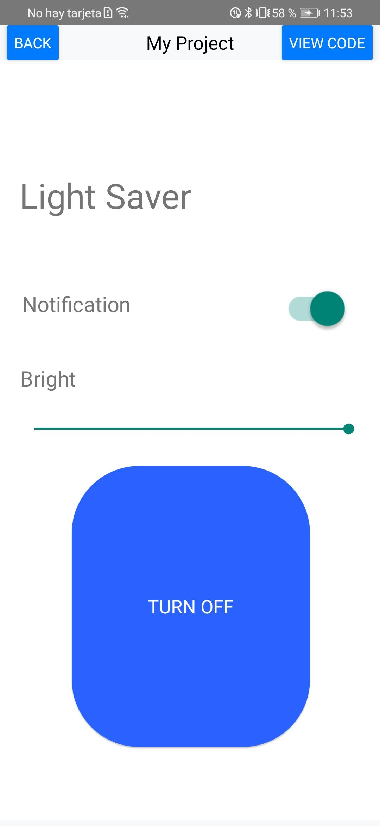
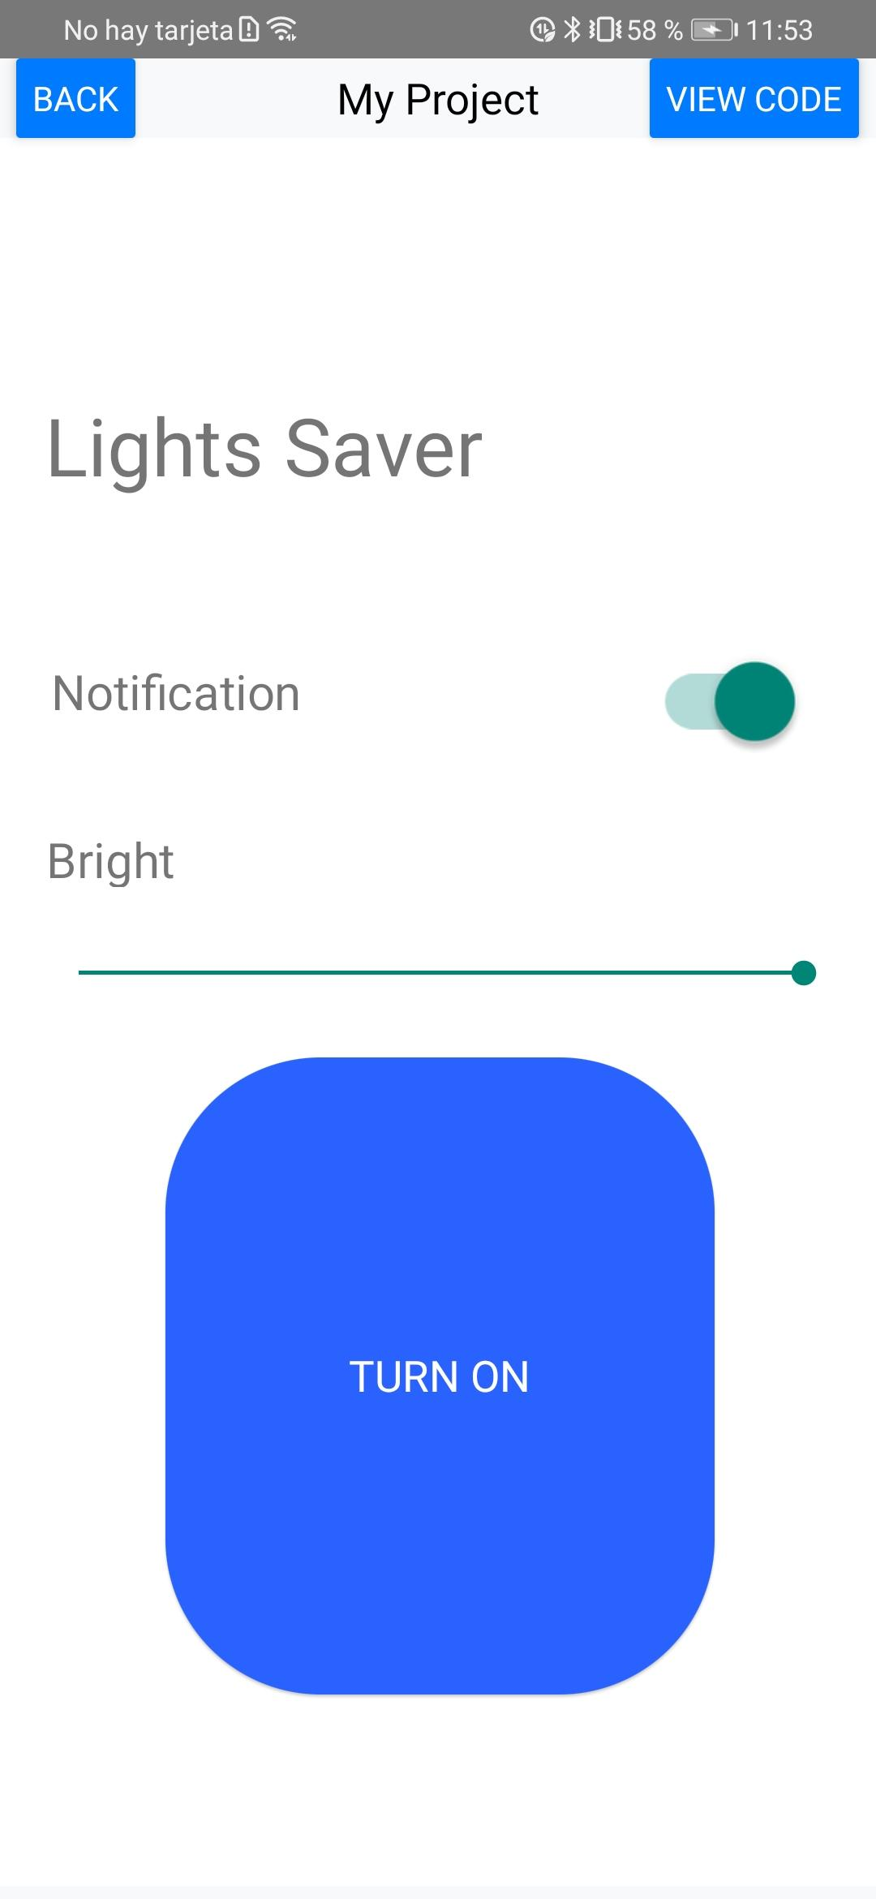
Prototyping
App quick design made with thunkable:
Bright and notification variable must maintain after turn on or turn off

Slide 4
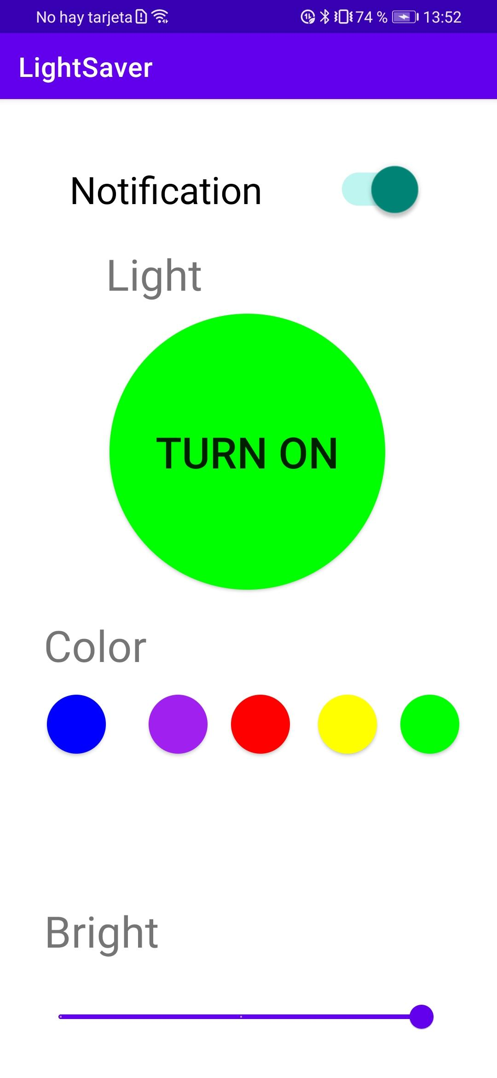
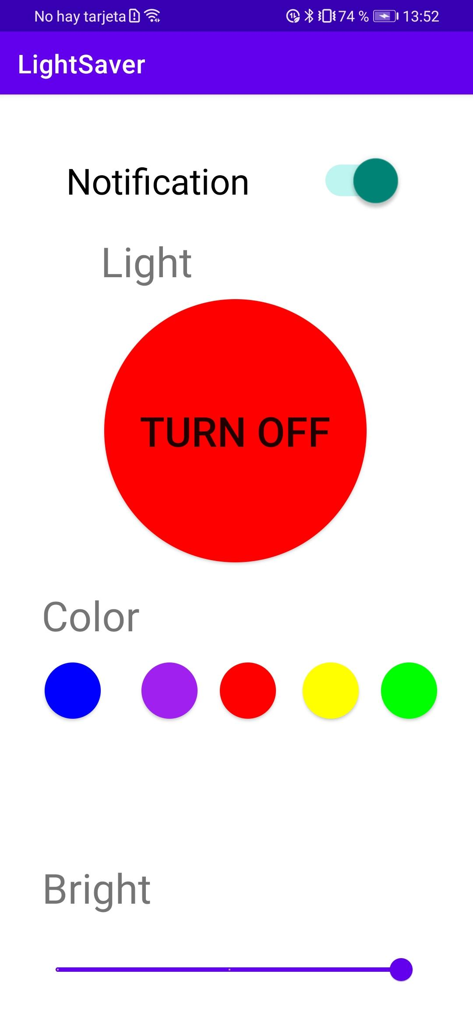
App design
All buttons save the values on variables to be send to a microcontroller
To do:
Data transfer to the microcontroller

Slide 5
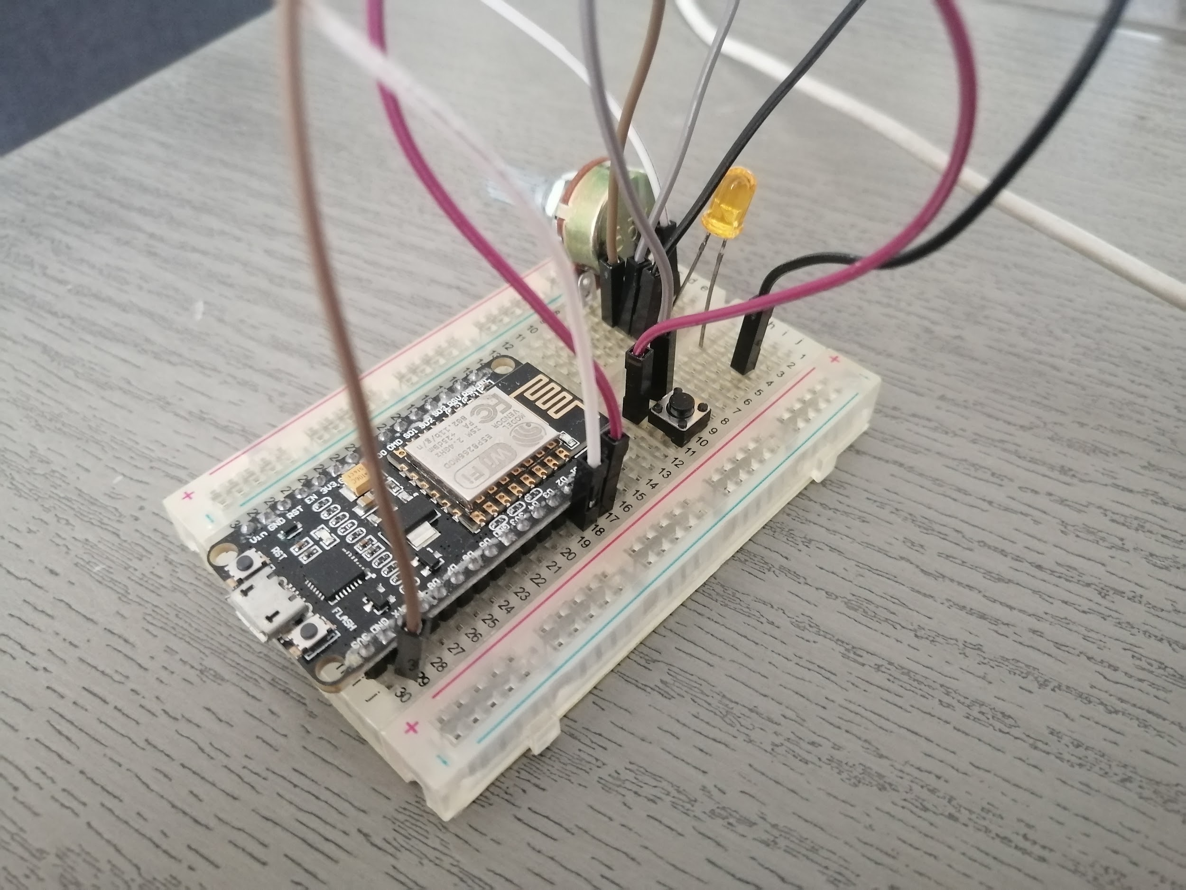
Microcontroller
The Esp8266 is a microcontroller with an internet module. It can process information and have outputs and inputs for physical devices.
ToDO:
Add light sensor and testing
Add web server
Add connectivity to mobile app

